Slide 1
Space and Time Complexity

Slide 2
Space and Time Complexity
To analyze an algorithm means:
developing a formula for predicting how fast an algorithm is, based on the size of the input (time complexity),
and/or
developing a formula for predicting how much memory an algorithm requires, based on the size of the input (space complexity).
Usually, time is our biggest concern
Most algorithms require a fixed amount of space

Slide 3
Size of the input ?
Problem | Size of the Input
Searching an element in an array of size n | n
Sorting n elements | n
Merging two arrays | Sum of size of two array
Adding two matrices of order m x n | m and n
Multiplying two matrices or order m x n and n x p | m, n and p

Slide 4
Space Complexity
Depends on
Data Space:
Space needed by the constants and simple variables
Space needed by dynamically allocated objects
Environmental Stack Space: used to save information needed to resume execution of partially completed methods and functions.
Example: if function f() invokes function g(), then we must save at least a pointer to the instruction of f() to be executed when g() terminates.
Instruction Space: Space needed to store the compiled version of the program instruction
Compiler Dependent

Slide 5
Space Complexity Contd…
The space requirement of any program P can be written as:
S = C + S_{p}(size of the input), where c denotes fixed part and S_{p} denotes the variable component
We are interested in Variable Component.

Slide 6
In C++ data size

Slide 7
Space Complexity Example: Sequential or Linear Search
Int SequentialSearch(int a[], int n, const int& x) a[0] a[1] ….a[n-1]
{
int i;
for (i = 0; i < n && a[i] != x; i++);
if (i == n) return -1;
else return i;
}
Space needed by parameters a, n and x = 4 + 4 + 4 = 12 bytes (integer type)
Space needed by variable i = 4 bytes
Space needed by constants 0 and -1 = 4 + 4 = 8 bytes
Total Space needed = 24 bytes (Constant ) therefore, Sp(n)=0
Complexity = O(1)

Slide 8
Space Complexity Example: Recursive Sequential Search
Int RSequentialSearch(int a[], int n, const int& x)
{
if ( n < 1) return -1;
if (a[n-1] == x) return n-1;
return RSquentialSearch(a n-1, x);
}
Ignore the constant space needed and find Environmental stack space.
Environment Stack Space:
RSequentialSearch (a, n, x)
RsequentialSearch (a, n-1, x)
…..
……
RSequentialSearch(a, 1, x)
RSequentialSearch (a, 0, x)
Therefore, depth of recursion: n + 1
Each time for recursive calls, a, n, x and return address stored in stack. Since all are integers, 4 * 4 = 16 bytes needed.
Therefore, total environmental stack space = 16 (n+1) bytes= O(n).

Slide 9
Write a C++ function for finding sum of array elements. Write both iterative and recursive program and find its space complexity.
int sum (int a[], int n)
{
int result;
for(int i=0; i<n; i++)
result= result + a[i];
return result;
}
int Rsum (int a[], int n)
{
if (n > 0)
return Rsum(a, n-1) + a[n-1];
return 0;
}
Rsum(a, n) Rsum(a, n-1)….Rsum(a,1), Rsum(a, 0) therefore, depth= n+1
Sp(n) = 0 constant space O(1)
Sp(n) = 12 (n+1) bytes =O(n)

Slide 10
Data Space Examples
i. Int *a;
a = new int [n]; Space needed 4n Bytes (n integers, each need 4 Bytes)
ii. Int a[30]; 4 x 30 = 120 Bytes
iii. int **A;
A = new int * [m];
for(int i=0; i<m; i++)
A[i] = new int [n];
Space allotted for matrix A is 4mn bytes. O(mn) space complexity.

Slide 11
Tutorial (Solve and upload in class file section tutorial week1 folder)
1. Write a C++ function for maximum and minimum element in an array and find its space complexity. [Do not write full program with main() function. Only function code need to be written.]
2.
Show that p(n) is asymptotically bigger than q(n)
Show that

Slide 12
Time Complexity

Slide 13
Time complexity
Operation Count Method
Step Count Method

Slide 14
Operation Count Method
Identify one or more key operations in the algorithm/program and count how many times each key operation is performed in the algorithm.
Examples
Matrix multiplication:
Key operations are addition and multiplications
Sorting:
Key operations are comparison and swapping.
Searching:
Comparison

Slide 15
Matrix Multiplication
void matrixMultiply(int **a, int **b, int **c, int m, int n, int p)
{
// Multiply the m x n matrix a and the n x p matrix b to get c.
for (int i = 0; i < m; i++)
for (int j = 0; j < p; j++)
{
int sum = 0;
for (int k = 0; k < n; k++)
sum += a[i][k] * b[k][j];
c[i][j] = sum;
}
}
Key operations are addition and multiplications
Additions mnp times
Multiplications mnp times
Complexity O(mnp)

Slide 16
Polynomial Evaluation: p(x)=c_{n}x^{n}+ c_{n-1}x^{n-1} + . . . + c₁ x + c₀
double polyEval(double c[], int n, const double& x)
{// Evaluate the degree n polynomial with
// coefficients coeff[0:n] at the point x.
double y = 1, value = c[0];
for (int i = 1; i <= n; i++)
{// add in next term
y *= x;
value += y * c[i];
}
return value;
}
No. of additions = n
No. of Multiplications = 2n
Complexity = O(n)
4x^3 + 5x + 3
C3 = 4
C2=0
C1=5
C0=3

Slide 17
Horner’s Rule for Polynomial Evaluation p(x)=c_{n}x^{n}+ c_{n-1}x^{n-1} + . . . + c₁ x + c₀
Normal Method: value = c₀ , y=1
y=y*x = x
value = value + c₁y = c₁x+ c₀
y=y*x = x²
value = value + c₂y = c₂x² + c₁x + c₀
……
…..
value = c_{n}x^{n}+ c_{n-1}x^{n-1} + . . . + c₁ x + c₀
Horner’s Method:
value = c_{n}
value = value *x + c_{n-1} = c_{n} x + c_{n-1}
p(x)= value *x + c_{n-2} = = c_{n} x² + c_{n-1} x + c_{n-2}
……
…..
p(x)= c_{n}x^{n}+ c_{n-1}x^{n-1} + . . . + c₁ x + c₀
5x³ - 4x² + 2x + 7 = ((5x – 4)*x + 2)x +7

Slide 18
Horner’s Rule for Polynomial Evaluation
double Horner(double c[], int n, const double& x)
{// Evaluate the degree n polynomial with
// coefficients c[0:n] at the point x.
double value = c[n];
for (int i = 1; i <= n; i++)
value = value * x + c[n - i];
return value;
}
No. of additions = n
No. of Multiplications = n
Complexity = O(n)

Slide 19
Rank of an Element in a Sequence
The rank of an element in a sequence is the number of smaller elements in the sequence plus the number of equal elements that appears to its left.
example: a = [4, 3, 9, 3, 7]
Rank r = [2, 0, 4, 1, 3]
Rank Sort: Sorting elements in an array based on their ranks

Slide 20
Rank of an Element in a Sequence
Key Operation: Comparison
Number of times a[j] <= a[i] occurs is
i=1 j takes the value 0
1 comparison
i=2 j takes the value 0, 1
2 comparison
….
i=n-1 j takes the value 0, 1, …, n-2
n-1 comparison
Total Comparisons = 1 + 2 + … + n-1= n (n – 1 )/2
= O(n²)
void rank(int a[], int n, int r[])
{// Rank the n elements a[0:n-1].
// Element ranks returned in r[0:n-1]
for (int i = 0; i < n; i++)
r[i] = 0; // initialize
// compare all element pairs
for (int i = 1; i < n; i++)
for (int j = 0; j < i; j++)
if (a[j] <= a[i]) r[i]++;
else r[j]++;
}

Slide 21
Rank Sort
void rearrange(T a[], int n, int r[])
{
int *u = new int [n]; // create additional array
// move to correct place in u
for (int i = 0; i < n; i++)
u[r[i]] = a[i];
// move back to a
for (i = 0; i < n; i++)
a[i] = u[i];
delete [] u;
}
Example: a = [4, 3, 9, 3, 7] Rank r = [2, 0, 4, 1, 3]
U[2]=4 , u[0]=3, u[4]=9, u[1]=3, u[3]=7
a = u = [3, 3, 4, 7, 9]
Finding Rank : O(n²)
Rearrangement takes O(n) time
Total Complexity of Rank Sort = O(n²)

Slide 22
Selection and Bubble Sort

Slide 23
Selection Sort
void selectionSort(int a[], int n)
{// Sort the n elements a[0:n-1].
for (int size = n; size > 1; size--)
{
int j = indexOfMax(a, size);
swap(a[j], a[size - 1]);
}
}
int indexOfMax(int a[], int n)
{// Locate the largest element in a[0:n-1].
int indexOfMax = 0;
for (int i = 1; i < n; i++)
{
if (a[indexOfMax] < a[i])
indexOfMax = i;
}
return indexOfMax;
}
0 1 n-1
a=

Slide 24
Selection Sort
void selectionSort(int a[], int n)
{
for (int size = n; size > 1; size--)
{
int j = 0, temp;
for (int k = 1; k < size; k++)
{
if (a[j] < a[k])
j = k;
}
temp=a[j];
a[j]=a[size-1];
a[size-1]=temp;
}
}
Swap operation ∑₂^{n} 1 = (n – 1) times
Comparisons:
when size = n , k = 1, 2, … , n-1
when size = n-1, k = 1, 2, …,, n-2
…..
……
when size = 2, k= 1
Total comparison = 1 + 2 + … + n-1
= n (n-1)/2 = O(n²)
∑₂^{n} (size-1) = 1+2+…+(n-1)

Slide 25
Bubble Sort
void bubble(int a[], int n)
{// Bubble largest element in a[0:n-1] to right.
for (int i = 0; i < n - 1; i++)
if (a[i] > a[i+1]) swap(a[i], a[i + 1]);
}
void bubbleSort(int a[], int n)
{// Sort a[0:n - 1] using bubble sort.
for (int i = n; i > 1; i--)
bubble(a, i);
}
void bubbleSort(int a[], int n)
{
for (int i = n; i > 1; i--)
{
for (int j = 0; j < i - 1; j++)
{
if (a[j] > a[j+1]) swap(a[j], a[j + 1]);
}
}
}

Slide 26
Insert An Element into Sorted Array
Given a sorted list/sequence, insert a new element
Given 3, 6, 9, 14
Insert 5
Result 3, 5, 6, 9, 14

Slide 27
Insert an Element into Sorted Array
3, 6, 9, 14 insert 5
Compare new element (5) and last one (14)
Shift 14 right to get 3, 6, 9, , 14
Shift 9 right to get 3, 6, , 9, 14
Shift 6 right to get 3, , 6, 9, 14
Insert 5 to get 3, 5, 6, 9, 14

Slide 28
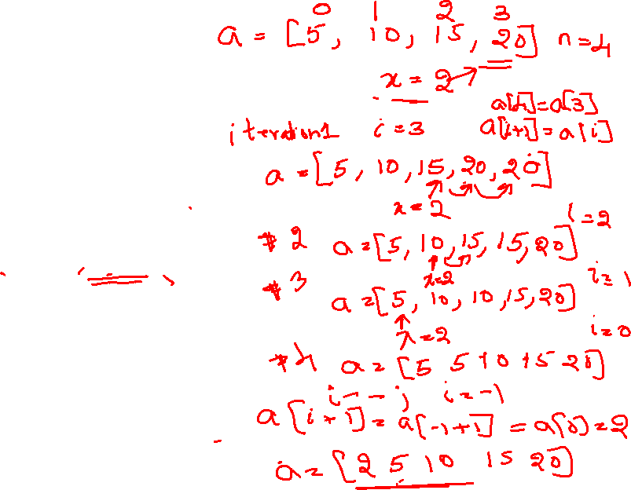
Insert an Element into Sorted Array
void insert(int a[], int n, int x)
{
for (int i = n - 1; i >= 0 && x < a[i]; i--)
a[i+1] = a[i];
a[i+1] = x; // insert x
}
Key operation Comparison Total comparison = n Complexity: O(n)

Slide 29
Insertion Sort
void insert(int a[], int n, const int& x)
{
for (int i = n-1; i >= 0 && x < a[i]; i--)
a[i+1] = a[i];
a[i+1] = x;
}
void insertionSort(int a[], int n)
{// Sort a[0:n-1] using the insertion sort method.
for (int i = 1; i < n; i++)
{ \\ insert a[i] into a[0:i-1]
int t = a[i];
insert(a, i, t);
}
}

Slide 30
Insertion Sort
void insertionSort(int a[], int n)
{
for (int i = 1; i < n; i++)
{// insert a[i] into a[0:i-1]
int t = a[i];
for (int j = i - 1; j >= 0 && t < a[j]; j--)
a[j + 1] = a[j];
a[j + 1] = t;
}
}
i =1, j=0, 1 comparison
i=2, j = 0, 1 2 comparisons
….
…..
i = n-1, j= 0, 1,…, n-2 n-1 comparisons
Total Comparisons = 1 + 2 + …. + (n-1)
= n(n-1)/2 = O(n²)

Slide 31
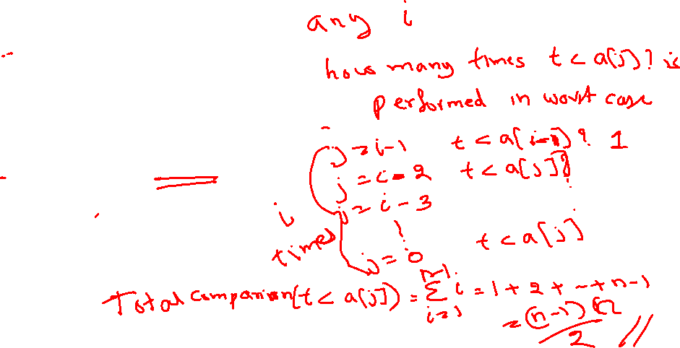
Insertion Sort
void insertionSort(int a[], int n)
{
for (int i = 1; i < n; i++)
{// insert a[i] into a[0:i-1]
int t = a[i];
for (int j = i - 1; j >= 0 && t < a[j]; j--)
a[j + 1] = a[j];
a[j + 1] = t;
}
}
i =1, j=0, 1 comparison
i=2, j = 0, 1 2 comparisons
….
…..
i = n-1, j= 0, 1,…, n-2 n-1 comparisons
Total Comparisons = 1 + 2 + …. + (n-1)
= n(n-1)/2 = O(n²)

Slide 32
Time Complexity : Step Count Method
A step is a meaningful instruction of the program
A step is an amount of computing that does not depend on the instance characteristic (input size)
10 adds, 100 subtracts, 1000 multiplies can all be counted as a single step
n adds or n/2 adds, p+q addition, p-q additions cannot be counted as 1 step

Slide 33
Complexity of Insertion Sort: Step Count Method
s/e frequency Total Steps
void insertionSort(int a[], int n)
{
for (int i = 1; i < n; i++)
{// insert a[i] into a[0:i-1]
int t = a[i];
for (int j = i - 1; j >= 0 && t < a[j]; j--)
a[j + 1] = a[j];
a[j + 1] = t;
}
}

Slide 34


Complexity of Insertion Sort: Step Count Method
s/e frequency Total Steps
void insertionSort(int a[], int n) 0 0 0
{ 0 0 0
for (int i = 1; i < n; i++) 1 n n
{// insert a[i] into a[0:i-1]
int t = a[i]; 1 n-1 n-1
for (int j = i - 1; j >= 0 && t < a[j]; j--) 1 n(n+1)/2 - 1
a[j + 1] = a[j]; 1 n(n-1)/2
a[j + 1] = t; 1 n-1 n-1
}
} Total Steps = n² – 3n – 3 = O(n²)
$$\sum_{i=1}^{n−1}{\left(i+1\right)}$$
$$\sum_{i=1}^{n−1}{\left(i\right)}$$

Slide 35
void selectionSort(int a[], int n)
{
for (int size = n; size > 1; size--)
{
int j = 0, temp;
for (int k = 1; k < size; k++)
{
if (a[j] < a[k])
j = k;
}
temp=a[j];
a[j]=a[size-1];
a[size-1]=temp;
}
}

Slide 36
void bubble(int a[], int n)
{// Bubble largest element in a[0:n-1] to right.
for (int i = 0; i < n - 1; i++)
if (a[i] > a[i+1])
{ //swap
temp=a[i];
a[i]=a[i+1];
a[i+1]=temp;
}
}
void bubbleSort(int a[], int n)
{// Sort a[0:n - 1] using bubble sort.
for (int j = n; j > 1; j--)
bubble(a, j);
}

Slide 37
Step Count Method: Few more examples
int n; \\ assume n as power of 2
while (n>1)
n=n/2;
2. int x=0;
for(int i=0; i<m; i++)
for (int j=0; j<n; j++)
for(int k=0; k<p; k++)
x = x+1;
What is the final value of x? how many times for loop for k will execute?

Slide 38
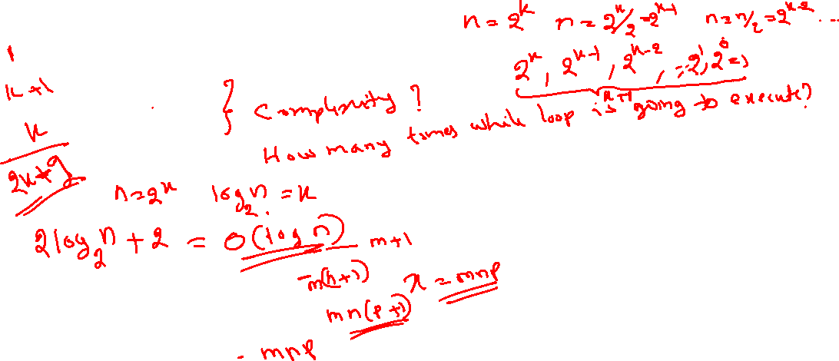
Step Count Method: Few more examples
int n; \\ assume n as power of 2
while (n>1)
n=n/2;
2. int x=0;
for(int i=0; i<m; i++)
for (int j=0; j<n; j++)
for(int k=0; k<p; k++)
x = x+1;
What is the final value of x? how many times for loop for k will execute?

Slide 39
Step Count Method: Few more examples
double n; \\ assume n =2^{k} and k as power of 2
while (n>=2)
n=sqrt(n);
int a = 0;
for (i = 0; i < N; i++) {
for (j = N; j > i; j--) {
a = a + i + j;
}
}

Slide 40
Reference:
Sartaj Sahani, Data Structures Algorithms and Applications in C++, Second Edition, Universities Press (India) Private Ltd, 2005.

Slide 41
Thank You

